Slide 1



NIT ConclaveX – Genesis ‘22
Robot Operating System
By, Robotics and Machine Intelligence (RMI)

Slide 2


What is ROS?
Software framework for programming robots
ROS is used as a framework which allows us to connect different parts of a robot together to build a modular system which can function as a single inter-linked unit.
It has a suite of simulation/visualisation tools to simulate the performance of the robot.
Consists of infrastructure, tools, capabilities, and ecosystem (open source)
Features:
Agent based (nodes)
Message passing
Publish
Subscribe
Supports numerous programming languages (C++, Python, java)
A meta-operating system for robots

Slide 3

What is ROS?
Low level device abstraction
Joystick
GPS
Camera
Controllers
Laser Scanners
…
Application building blocks
Coordinate system transforms
Visualization tools
Debugging tools
Robust navigation stack (SLAM with loop closure)
Arm path planning
Object recognition
...
Application building blocks
System software

Slide 4
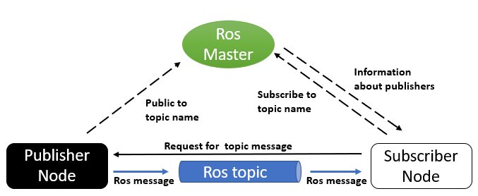
Building Blocks of ROS
Node
Messages
Topics
Master

Slide 5
Building Blocks of ROS
ROS Node:
A ROS Node is a piece of software/executable that uses ROS to communicate with other ROS Nodes.
For example, if you have a wall-following robot then one ROS Node could get distance sensor values and another node can control the motors of the robot. So, these two nodes will communicate with each other in order to move the robot.
ROS Messages:
The information/data transmitted from one node to another is called as messages in ROS.
ROS messages are defined by the type of message and the data format.
Following the previous example, if we have a wall-following robot then one ROS node publishes the distance sensor values in a topic called sensor_values and another node subscribes to this topic to receive the distance sensor values.
Notes:
You can write your entire ROS Application in a single node but having multiple nodes ensures that if a node crashes it won't crash your entire ROS application.

Slide 6
Building Blocks of ROS
ROS Topics
The information in ROS is transmitted through something called a topic.
The nodes that transmit data publish the topic name and the type of message to be sent.
Another node can subscribe to a topic and transmitted messages on that topic are received by the node subscribing.
Following the previous example, if we have a wall-following robot then one ROS node publishes the distance sensor values in a topic called sensor_values and another node subscribes to this topic to receive the distance sensor values.

Slide 7
Building Blocks of ROS
ROS Master:
The ROS Master allows us to setup and establish communication between different nodes and services.
It tracks publishers and subscribers to topics as well as services.
The role of the ROS Master is to enable individual ROS nodes to locate one another.
Once these nodes have located each other they communicate with each other peer-to-peer.
Notes:
You can write your entire ROS Application in a single node but having multiple nodes ensures that if a node crashes it won't crash your entire ROS application.

Slide 8
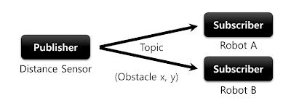
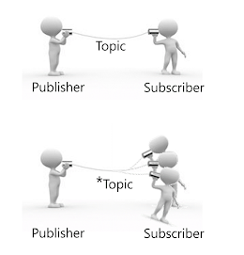
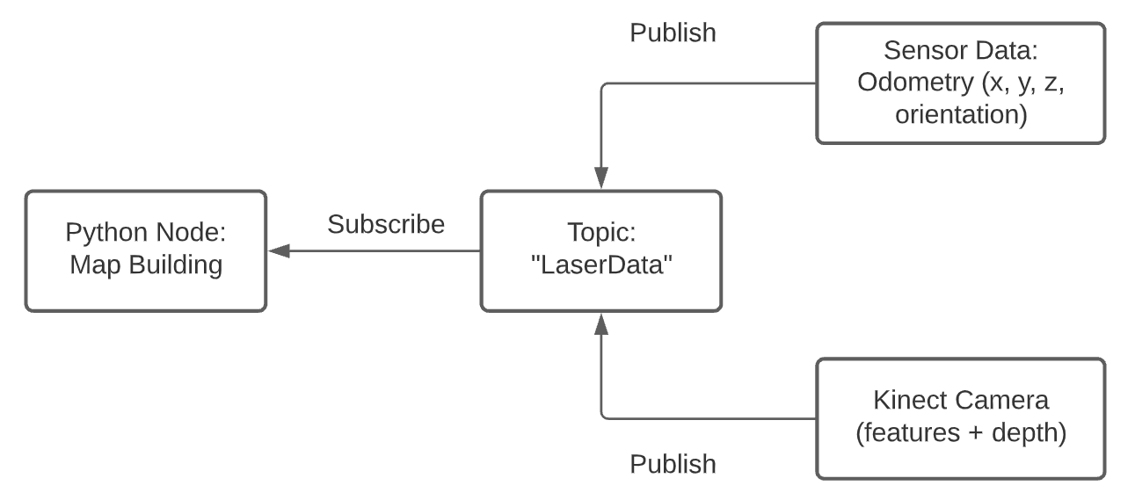
Publisher can publish to one or more Topic and a Subscriber can subscribe to one or more Topic.
Publish/Subscribe Tools:
rosnode list - lists all the active nodes
rosnode info /some_node - info about particular node
rostopic list - lists all the topics
rostopic info /some_topic - info about particular topic
rostopic echo /some_topic - prints the info in real time
Ex: SLAM Algorithm

Slide 9
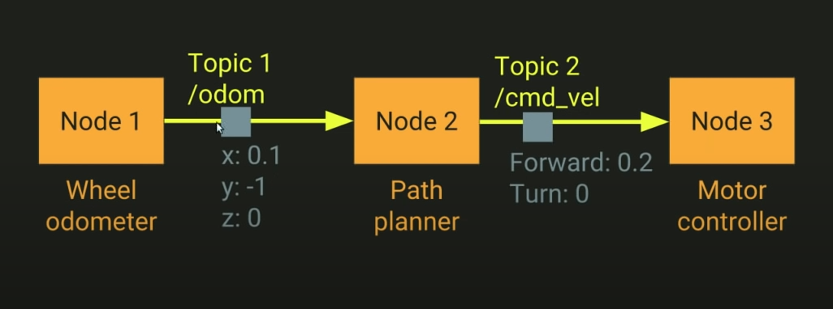
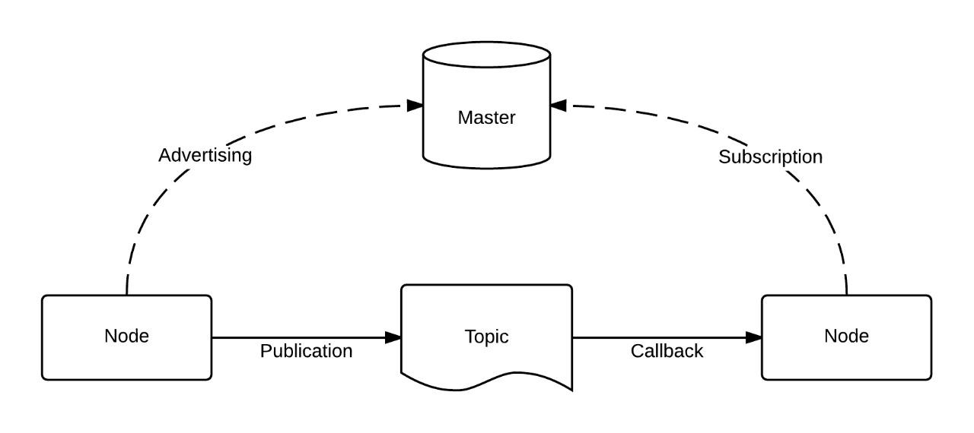
ROS for Communication

Slide 10
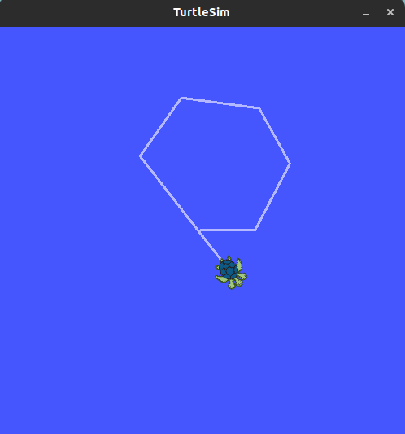
Running Turtlesim in ROS
Turtlesim is a simple 2D graphical simulator which we are going to use to run the turtlebot.
Open the terminal :
press Ctrl +Alt +T
->roscore
roscore command starts master, parameter server, logging
->rosrun turtlesim turtlesim_node
Notes:
this will be a nice intro to the final robot you will be working

Slide 11
Controlling Turtle with Keyboard :
->roscore
roscore command starts master, parameter server, logging
->rosrun turtlesim turtlesim_node
->rosrun turtlesim turtle_teleop_key
Now you must be able to control the
turtlebot by pressing the arrow keys
in the terminal.

Slide 12
This is a pretty good analogy for a robot. Here the turtlebot is a analogy for any robot that we might want to deploy.
The turtle_teleop_key is a analogy for any human controller/ autonomous algorithm that we wish to implement in our robot.
Here the data of your key press is communicated from turtle_teleop_key node to turtlesim_node through ROS.
The turtlesim_node and the turtle_teleop_key node are communicating with each other over a ROS Topic named turtle1/cmd_vel.
We can say that turtle_teleop_key publishes the key press data over the ROS topic, the node turtlesim_node subscribes to this topic.
Therefore by subscribing to this topic, the turtlesim_node is able to use the data.

Slide 13
CHALLENGE !!
Try to draw “8” using turtle_teleop_key
And post the image you’re getting in the Chatbox
To snip the image :
Press Win+Shift+S

Slide 14
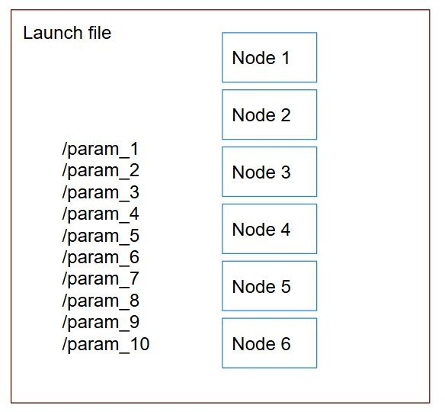
ROS Launch Files
Launch files contain a list of all nodes and parameters that are to be launched together.
The idea is to mention all the nodes that you want to run, all the config files that you want to load etc in a single file which you can run using roslaunch command.
Once a launch file has been created for a project it can be launched using the following command.
->roslaunch package_name file.launch
Notes:
You can write your entire ROS Application in a single node but having multiple nodes ensuresthat if a node crashes it won't crash your entire ROS application.

Slide 15
How is Subscribing and Publishing Done?
Let’s assume our python node is “listener”
rospy.init_node('listener', anonymous=True) — initializing the node
It subscribes to a topic “chatter”
Message type : String
Callback : this function is called whenever the node receives new messages
pub = rospy.Publisher('chatter', String, callback) — Getting data from chatter topic
We then publish data to the topic
hello_str = "hello world"
pub.publish(hello_str)

Slide 16
Catkin Workspace
catkin is the official build system of ROS and the successor to the original ROS build system, rosbuild.
In a catkin workspace there are three directories:
src - The src folder contains the source code of catkin packages.
build - The build folder is where CMake is invoked to build the catkin packages in the src folder.
devel - The development folder (or devel folder) is where built targets are placed before being installed.

Slide 17
Creating a Catkin Workspace
A catkin workspace is required to run ROS.
To create a Catkin workspace
Source your environment
->source /opt/ros/melodic/setup.bash
Let's create and build a catkin workspace:
->cd ~/catkin_ws/
->catkin_make
The catkin_make command is a convenience tool for working with catkin workspaces. Running it the first time in your workspace, it will create a CMakeLists.txt link in your 'src' folder.

Slide 18
Creating a Catkin Workspace
Now to make your workspace visible to ROS. Source the setup file in the devel directory.
source ~/catkin_ws/devel/setup.bash
This setup.bash file of your workspace must be source every time when you want to use ROS packages created inside this workspace.
To save typing, add this to your .bashrc
1. ->gedit ~/.bashrc
2. Add to the end of the file:
->source ~/catkin_ws/devel/setup.bash
3. Save and close the editor.

Slide 19
ROS Package:
Software in ROS is organized in packages. A package might contain ROS nodes, a ROS-independent library, a dataset, configuration files, a third-party piece of software, or anything else that logically constitutes a useful module.
Creating a ROS Package - catkin_create_pkg:
->cd ~/catkin_ws/src
->catkin_create_pkg pkg_ros_basics std_msgs rospy roscpp
catkin_create_pkg requires that you give it a package_name
and optionally a list of dependencies on which that package depends.
->catkin_create_pkg <package_name> [depend1] [depend2] [depend3]

Slide 20
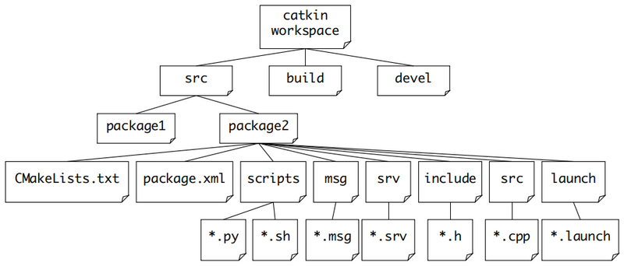

Slide 21
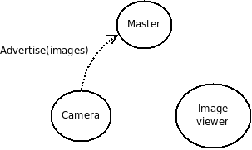
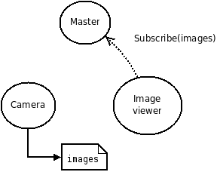
For instance, let's say we have two Nodes; a Camera node and an Image_viewer node. A typical sequence of events would start with Camera notifying the master that it wants to publish images on the topic "images":
Now, Camera publishes images to the "images" topic, but nobody is subscribing to that topic yet so no data is actually sent. Now, Image_viewer wants to subscribe to the topic "images" to see if there's maybe some images there:
Notes:
You can write your entire ROS Application in a single node but having multiple nodes ensures that if a node crashes it won't crash your entire ROS application.

Slide 22
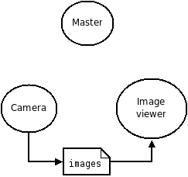
Now that the topic "images" has both a publisher and a subscriber, the master node notifies Camera and Image_viewer about each other's existence so that they can start transferring images to one another:

Slide 23

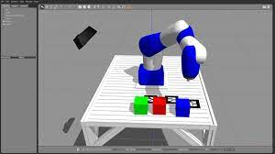
Gazebo
Gazebo is a multi robot simulator
It can accurately simulate population of robots, sensors and objects in 3D world
Includes accurate simulation of rigid body physics and sensor feedback.
Allows code to operate on a physical robot to be executed in artificial environment

Slide 24
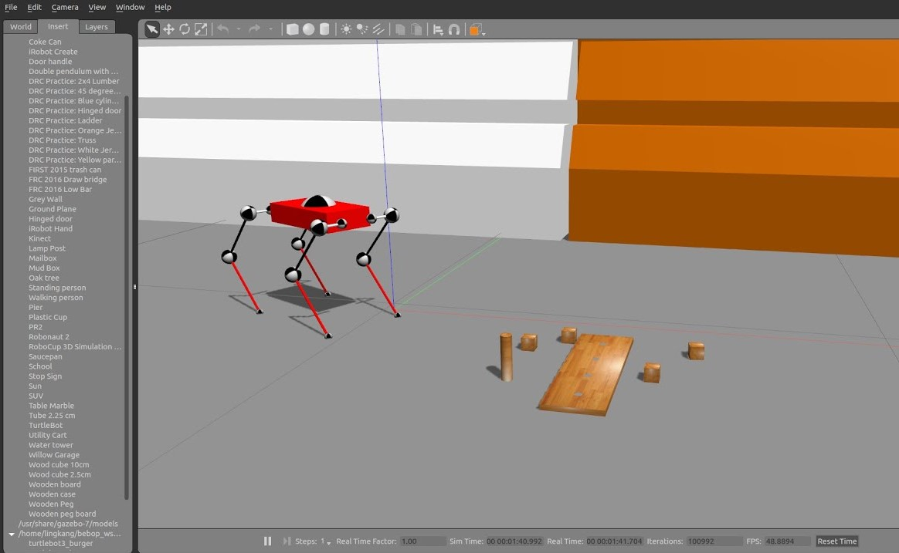

Slide 25
Gazebo Features
Dynamics Simulation
– Direct control over physics engine parameters
Building editor
– Create 3D model of buildings and objects from simple shapes to terrain within gazebo without a line of code
Advanced 3D graphics
– State of art GPU shaders generate realistic lighting and shadows
Sensors
– Support for laser range finders, 2D cameras, Kinect style sensors, contact sensors and RFID sensors
Environments
– Many robots including PR2, TurtleBot, generic robot arms and grippers.

Slide 26
World Description File
The world description file consist of all the elements in a simulation, including robots , lights, sensors and objects .
It is formatted using SDF (simulation description format) .
SDF :
Its an XML file. It contains description from world level to robot level, which includes:
Scene: Lighting, shadows, sky properties
Physics: Gravity, physics engine, time step
Models: Collection of links, Collision objects, joints and sensors
Lights; Point, spot, directional light sources
Plugins: World, model, sensor and system plugins

Slide 27
Spawning Objects in Gazebo
1) Start simulation of empty world:
$ rosrun gazebo_ros gazebo
This patch runs both gazebo server and GUI Opens a empty world
To load a saved world :
$ gazebo my_world.sdf
The world file should be in the working directory

Slide 28
URDF file, Just like SDF:
URDF file is used to represent a robot model.
It can only specify kinematics and dynamics of single robot in isolation.
It consists of
links – number of links in a bot
inertial
origin – pose of inertial reference frame
mass
inertia – rotational inertia
visual – visual properties of the link like the shape
name
origin
geometry
collision

Slide 29
2) Creating a simple box URDF :
1 <robot name="simple_box">
2 <link name="my_box">
3 <inertial>
4 <origin xyz="2 0 0" />
5 <mass value="1.0" />
6 <inertia ixx="1.0" ixy="0.0" ixz="0.0" iyy="100.0" iyz="0.0" izz="1.0" />
7 </inertial>
8 <visual>
9 <origin xyz="2 0 0"/>
10 <geometry>
11 <box size="1 1 2" />
12 </geometry>
13 </visual>
14 <collision>
15 <origin xyz="2 0 0"/>
16 <geometry>
17 <box size="1 1 2" />
18 </geometry>
19 </collision>
20 </link>
21 <gazebo reference="my_box">
22 <material>Gazebo/Blue</material>
23 </gazebo>
24 </robot>
We are naming this file as object.urdf
The dimension of this box is 1*1*2
We are adding collision object to it, to avoid collision, which may be the same size or larger compared to the object

Slide 30
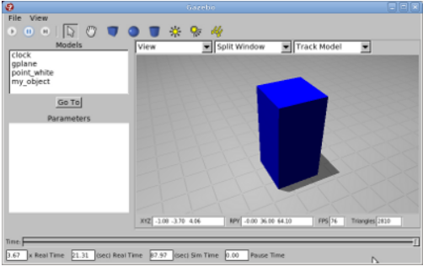
3) Spawn model in simulation
To spawn above URDF object at height z = 1 meter and assign the name of the model in simulation to be my_object
rosrun gazebo spawn_model -file `pwd`/object.urdf -urdf -z 1 -model my_object

Slide 31
Thank You !!

